Slide 3
What does the Thrive approach mean to you?
We are kind to children and so we do it all already.
Thrive is no different to what we already do.
Thrive gives the tricky children a chance to get out of learning
Notes:
TC420 V5

Slide 4
Containment refers to ways in which we keep a child safe and regulated- both emotionally and physically.
Containment for a child occurs when one person receives and understands the emotional communication of another without being overwhelmed by it.
All children who have not experienced being sufficiently contained emotionally as infants and young children will not have developed the ability to manage their feelings and will therefore need extra help.
The way these children manage their feelings and behaviours will nearly always be through negative behaviours that we and all peers find challenging; often they will not be able to verbalise what they are trying to communicate.
Notes:
TC420 V5

Slide 20
What Thrive now means for our setting
Questions

Slide 27
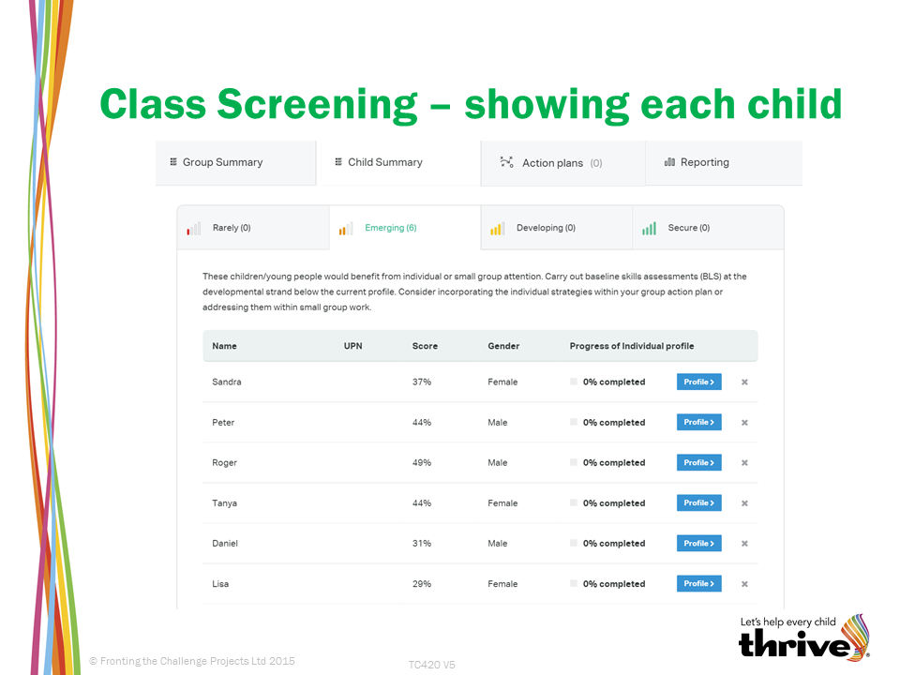

Slide 33
Notes:
TC420 V5

Slide 34
Notes:
TC420 V5

